Slide 1
Identifying Scenario Relevant Documents with Weak Supervision
Gaurav Bose
Eswar Lakshminarayan
Dr. Greg Ver Steeg
Information Sciences Institute

Slide 2
Identifying scenario-relevant documents without labeled training data
English scenario = “earthquake , disaster”
Bilingual
dictionary
Flood - hongee
IL documents
IL keywords: መሬት , መዓት
Apply focused methods on scenario documents:
Chinese room
Native informant
----
----
----
----
----
----
----
----
----
----
----
----
----
----
----
Semi-supervised topic learning in IL, e.g., “Anchored CorEx”
----
----
----
----
----
----
----
----
----
----
----
----
----
----
----
Can we successfully identify relevant documents?
Notes:
A general problem for low resource languages is that we don’t have enough coverage of words related to the scenario to learn good translations. We have explored ideas to improve coverage like the Chinese Room, but for this to be most effective, we have to identify a seed set of scenario relevant documents in the first place. Using a combination of unsupervised and semi-supervised methods directly on documents in the incident language, we should be able to find scenario relevant topics and then focus our efforts on these types of documents.
In the setup depicted here, we are given documents in the incident language (IL) and an English description of the relevant scenario. We look up some relevant keywords in the IL using a bilingual dictionary. Then we apply semi-supervised learning to learn topics that might be related to the scenario.
The question we are exploring is whether these methods can improve our ability to discover scenario relevant documents. We’ll consider two methods.

Slide 3
LDA & Guided LDA
Notes:
Imagine we have three documents with a four word vocabulary.
Documents are bag of word vectors.

Slide 4
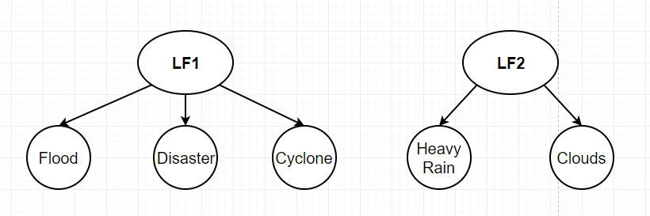
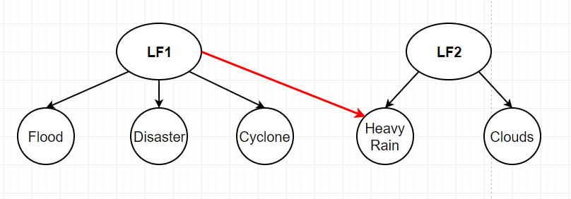
CorEx & Anchored CorEX
COREX
ANCHORED
COREX
Notes:
Imagine we have three documents with a four word vocabulary.
Documents are bag of word vectors.

Slide 5
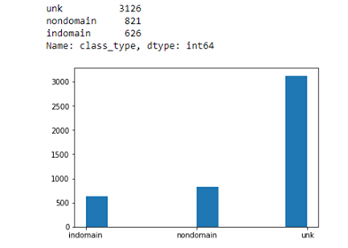
Document Type: Tigrinya
TRAINING DATA
TESTING DATA- UNSEQUESTERED
Notes:
Combination of monolingual and unsequestered data.

Slide 6
Keywords #1 and #2 - Tigrinya
SET A:
Topic 1 Earthquake : መሬት
Topic 2 Disaster : መዓት
SET A+B:
Topic 1 Earthquake : መሬት, ኣንቀጥቀጡ
Topic 2 Disaster : ሓደጋ, መዓት, ድንገተኛ
Topic 3 Drought : ድርቂ , ድርቅ, ድርቅን
Topic 4 Flood : ውሕጅ

Slide 7
Results - Tigrinya

Slide 8
Results - Tigrinya
Keywords #1 SET A
Keywords #2 SET A+B
Method | Precision | Recall | F1 Score |  | Precision | Recall | F1 Score
Base Model | 0.620 | 0.028 | 0.054 |  | 0.830 | 0.156 | 0.262
Corex- Anchorred | 0.800 | 0.198 | 0.317 |  | 0.803 | 0.287 | 0.423
Guided LDA | 0.300 | 0.038 | 0.067 |  | 0.497 | 0.281 | 0.359

Slide 9
Conclusion and future work
Preliminary results demonstrate improved identification of scenario-relevant documents.
1. Improve and automate keyword selection
Flood - hongee
IL documents
IL keywords: hongee, galaana
----
----
----
2. Test more strategies for improving semi-supervised learning as well as ranking documents such as TF-IDF.
----
----
----
----
----
----
----
----
----
Semi-supervised topic learning in IL, e.g., “Anchored CorEx”
----
----
----
----
----
----
----
----
----
----
----
----
----
----
----
----
----
----
Notes:
Our preliminary results show that we can improve the ability to discover scenario-relevant documents with weak supervision. The future work is in three areas: … (discuss a little about each point)
We saw that keyword selection had a big effect on quality of results. Both quantity and quality can have an effect.
(Talk about ideas for improvement)
Finally, we want to use these methods in conjunction with the Chinese Room to see whether we can actually improve coverage of scenario-related words.

Slide 10
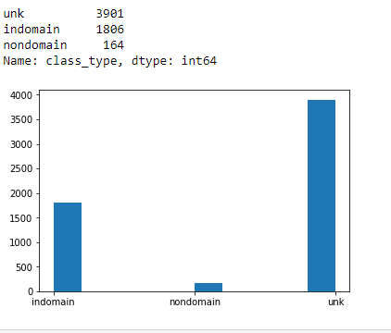
Document Type: Oromo

Slide 11
Keywords #1 and #2 - Oromo
Topic 1 Drought : hoongee, hongee
Topic 2 Flood : galaana, galaanaa
Topic 3 Disaster : balaa
Topic 1 Drought : hoongee, hongee, oolaa
Topic 2 Flood : galaana, galaanaa, guutuu, lolaa
Topic 3 Disaster : balaa, dhibee, irraa
Topic 4 Earthquake : sochii, lafaa

Slide 12
Results - Oromo

Slide 13
Results - Oromo
Keywords #1
More Keywords #2
Method | Precision | Recall | F1 Score |  | Precision | Recall | F1 Score
Corex- Anchorred | 0.889 | 0.089 | 0.162 |  | 0.902 | 0.138 | 0.24
Guided LDA | 0.885 | 0.103 | 0.184 |  | 0.823 | 0.059 | 0.110

